Slide 1
IS4432 Systems Design
Week 11: Designing Tests & Documentation
Adapted by Janet Yu

Slide 2
Agenda
Designing tests
Developing documentation

Slide 3
Key Definitions
Testing is a form of insurance.
  It costs more to repair software bugs when people are depending on the programs than in earlier stages before the systems are in use.
  The purpose of testing is to uncover as many errors as feasible.
Documentation provides information to make the system easier to use and repair.

Slide 4
Test Planning
Testing takes place throughout the development of an object-oriented system
Test plans define a series of tests to be conducted
Each test has a specific objective and describes specific test cases to examine
Stubs are hard-coded placeholders that allow testing using unfinished classes

Slide 5
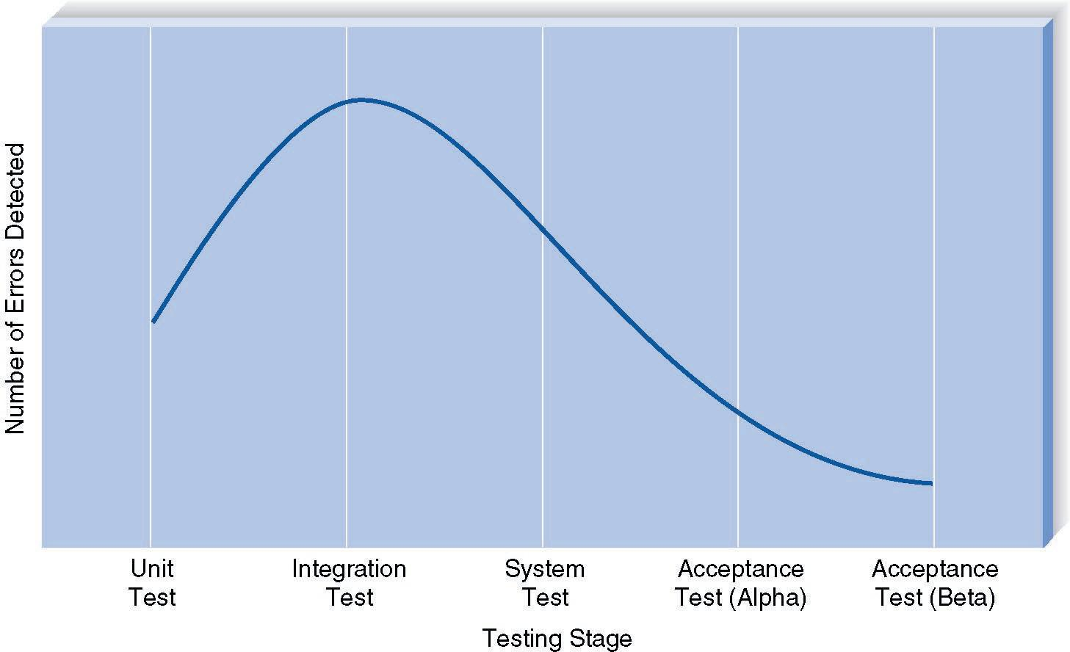
Error Discovery Rates By Test Stage

Slide 6
Categories of Testing
Unit testing
Integration testing
System testing
Acceptance testing

Slide 7
Unit Tests
Test each unit to ensure that it performs its function.
Unit tests focus on a single class
Black box testing examines externally visible behaviors of a class
  Driven by CRC cards and method contracts
  Tester knows nothing of how the class was coded
White box testing examines the internals of a class
  Driven by method specifications for the class

Slide 8

Integration Testing
  Assess whether a set of classes that must work together do so without error
Types of Tests | Purpose
User interface testing | Tests each interface function by moving through each menu item in the interface
Use-case testing | Ensures that each use case works correctly by going through each use case
Interaction testing | Tests each process in a step-by-step fashion
System interface testing | Tests the exchange of data with other systems

Slide 9
System Testing
  Conducted by systems analysts to ensure that all classes work together without error.
Type of Tests | Purpose
Requirements Testing | Tests to whether original business requirements are met
Usability Testing | Tests how convenient the system is to use
Security Testing | Tests disaster recovery and unauthorized access
Performance Testing | Assures that the system works under high volumes of activity
Documentation Testing | Tests the accuracy of the document

Slide 10
Acceptance Testing
Slide <number>
Done by users with support from the project team
To confirm that the system is complete, meet the business needs and is acceptable to the users
2 stages :
  Alpha Testing
    Repeats tests with made-up data by users
  Beta Testing
    Users test the system with real data
Also refer to the explanation on wikipedia

Slide 11
Developing Documentation
Developing Documentation

Slide 12
Developing Documentation
Documentation of the system must be done throughout system development
Two fundamentally different types
  System documentation is for those who install, maintain or build upon the system such as programmers and analysts
  User documentation is for the users
    Assume the users will not read the manuals before starting to use the system!
Online documentation is the norm today

Slide 13
Types of User Documentation
Reference Documents
  Tell users how to perform specific tasks, e.g. adding a new record
Procedure Manuals
  Describe how to perform business tasks, e.g. taking an order
  Each procedure normally entails multiple tasks
  Topics usually come from user scenarios
Tutorials
  Teach people how to use major components of a system, e.g. an introduction to the basic operations of the system

Slide 14
Designing Documentation Structure
Develop a set of documentation navigation controls that lead the user to documentation topics (see next slide)
Topics generally come from 3 sources
  Commands and menus in the user interface
  How to perform certain tasks
  Definitions of important terms

Slide 15
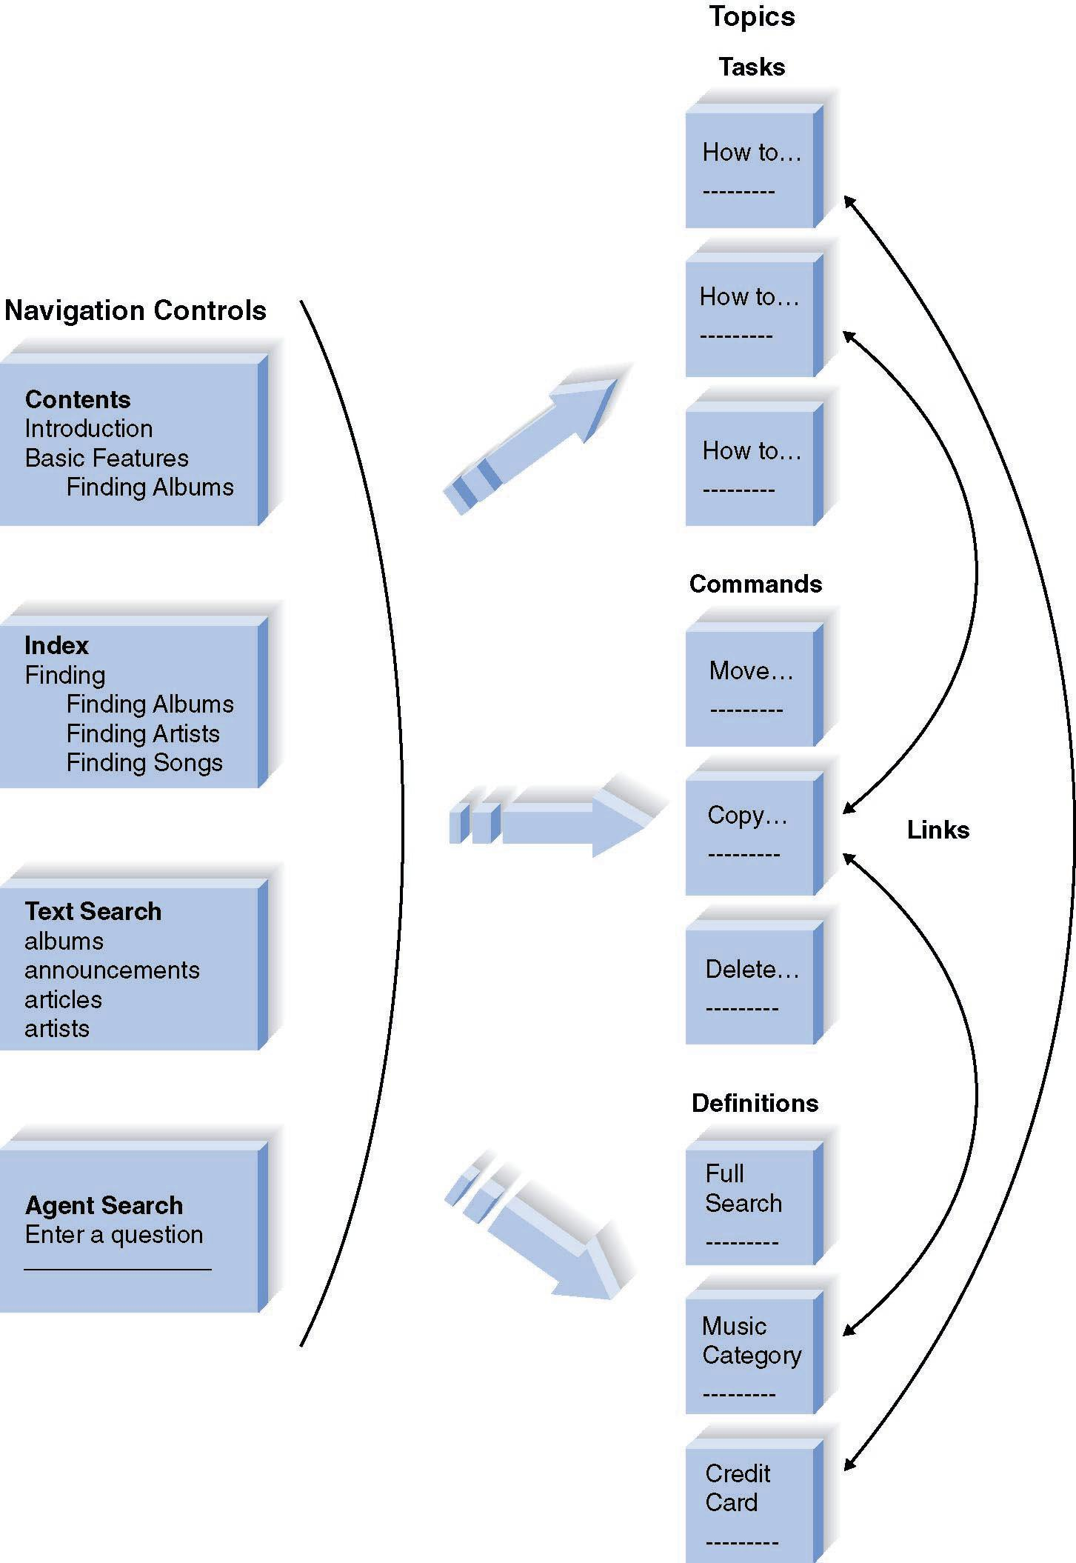
Organizing Online Reference Documents

Slide 16
General Types of Navigation Controls
Table of contents: organizes the information in a logical form
Index: provides access into the topics based on important keywords
Text search: provides search by any text
Intelligent agent: like the Microsoft Office Assistant
Weblike links between topics: enable the user to click and move among topics

Slide 17
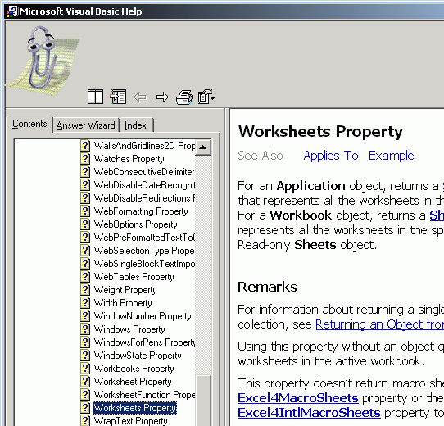
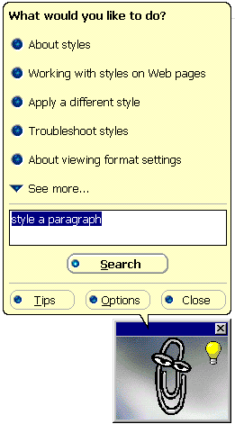
Designing Online Documentation Structure
  Identify navigation controls
    Index
    Text Search
    Table of contents
    Agent Search

Slide 18
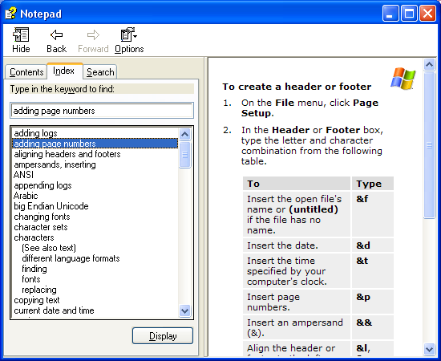
Online Help Example
Navigation buttons
Task title
Step-by-step instructions

Slide 19
Strengths of Online Documentation
Searching for information is often simpler
Same information can be presented several times in many different formats
Enables many new ways for the user to interact with the documentation such as “tool tips” – context sensitive
Less expensive
Always available

Slide 20
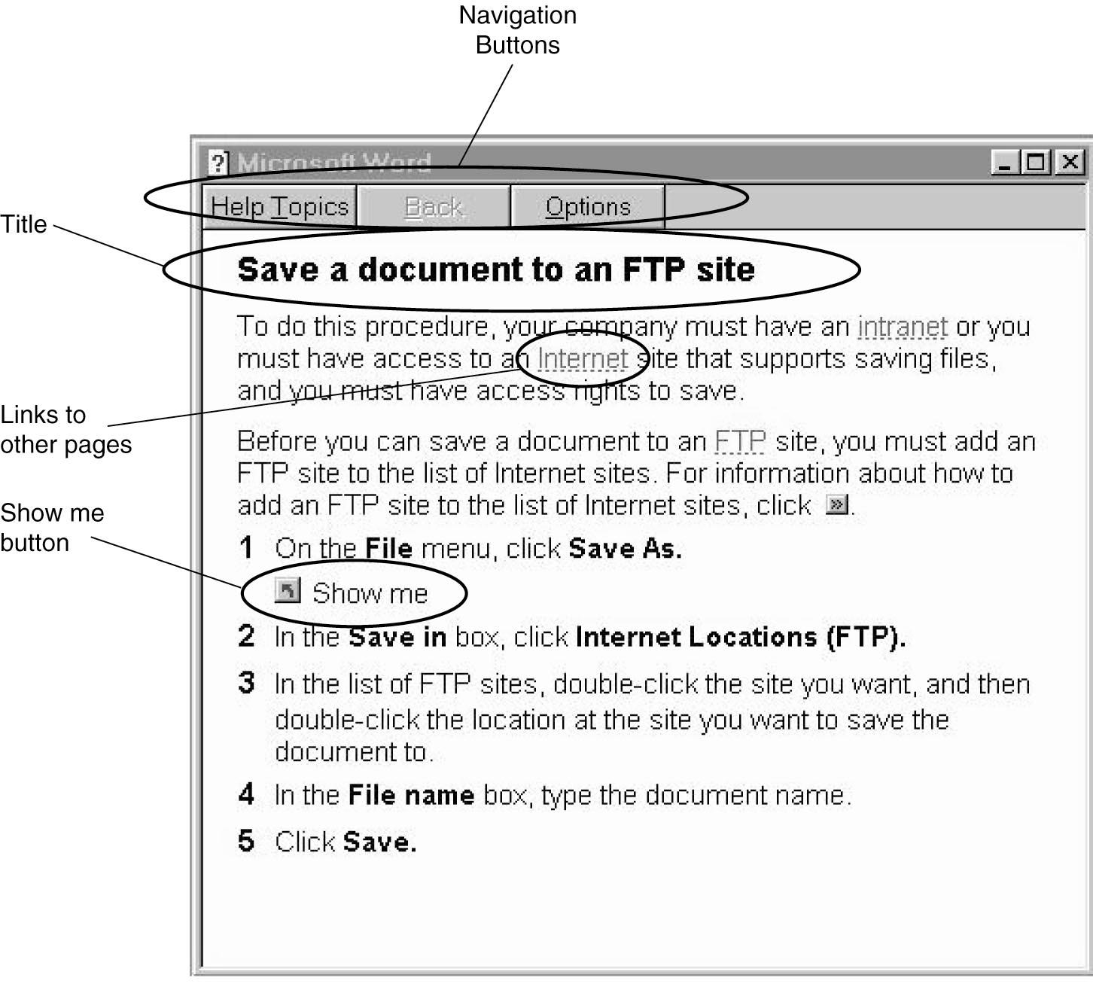
Designing the documents

